Slide 1



AD_HOC INSIGHTS CONSUMER GOODS
CREATED BY CHIRAG KANSAGARA

Slide 2
OBJECTIVE
Atliq Hardware (fictitious corporation) is one of the major computer hardware manufacturers in India, with a strong presence in other nations.
Nevertheless,the management did note that they do not have sufficient insights to make prompt, wise, and data-informed judgments. Plan to expand the data analytics team by adding junior data analysts.
To assess candidates, Data analytics director, Tony Sharma plans to conduct a SQL challenge to evaluate both tech and soft skills.
The company seeks insights for 10 ad hoc requests.

Slide 3
DATABASE INFORMATION
Given SQL file provides a comprehensive overview of the tables found in the 'gdb023' (atliq_hardware_db) database. It includes information for six main tables:
1. dim_customer: contains customer-related data
2. dim_product: contains product-related data
3. fact_gross_price: contains gross price information for each product
4. fact_manufacturing_cost: contains the cost incurred in the production of each product
5. fact_pre_invoice_deductions: contains pre-invoice deductions information for each product
6. fact_sales_monthly: contains monthly sales data for each product.

Slide 4
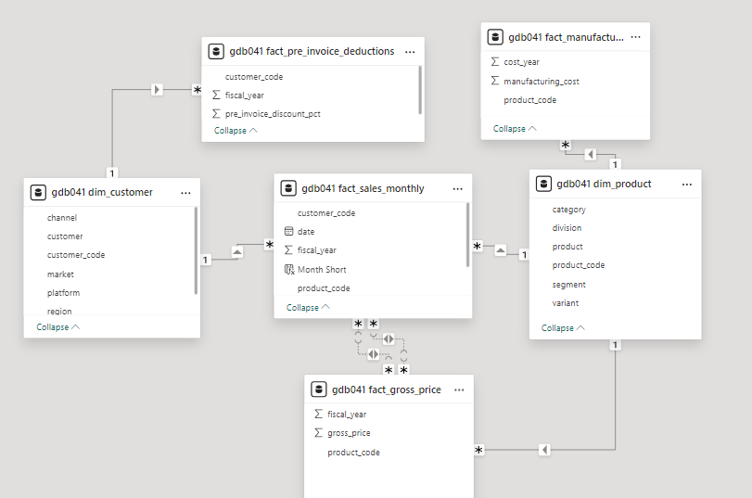
DATA MODELING IN POWER BI

Slide 5
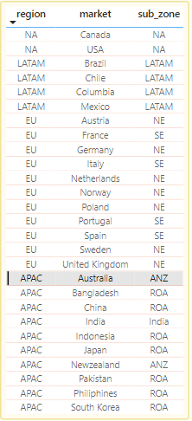
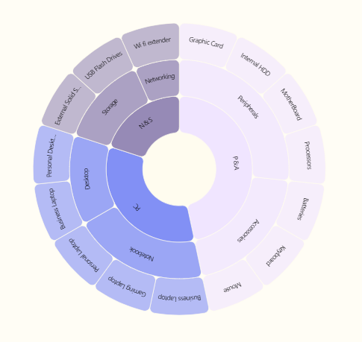
COMPANY DETAILS
6 segments
3 divisions
FISCAL YEAR 2020
Sep 2019- Oct 2021
FISCAL YEAR 2021
Sep 2020- Oct 2021
15 segments

Slide 6
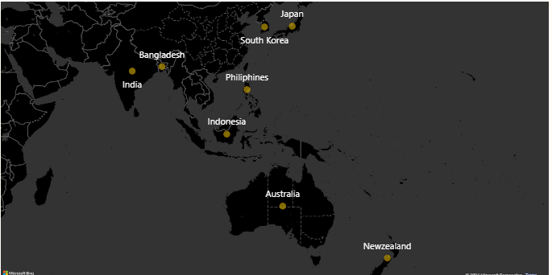
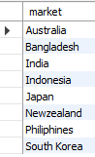
Ad_hoc Request 1
#1. provide the list of markets in which customer "Atliq Exclusive" operates its business in the APAC region

Slide 7
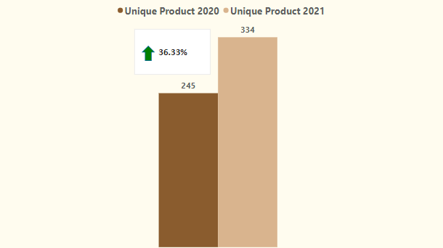
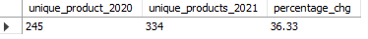
Ad_hoc Request 2
#2. What is the percentage of unique product increase in 2021 vs. 2020?
The final output contains these fields unique_products_2020 ,unique_products_2021, percentage_chg
Insights: demand and production both increased

Slide 8
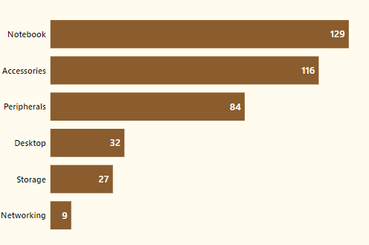
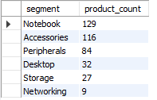
Ad_hoc Request 3
#3. Provide a report with all the unique product counts for each segment and sort them in descending order of product counts.
The final output contains 2 fields,segment ,product_count
Insights: notebooks, accessories, and peripherals are showing significant manufacturing growth as compared to desktops, storage, and networking. Notebooks, accessories, and peripherals constitute 83% of the total manufactured product.

Slide 9
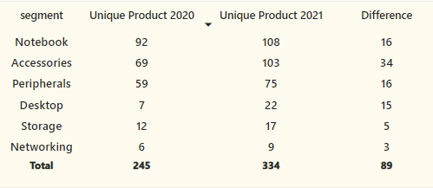
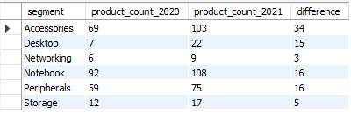
Ad_hoc Request 4
#4. Which segment had the most increase in unique products in 2021 vs 2020?
The final output contains these fields Segment, product_count_2020, product_count_2021, difference
Insights: Accessories had the largest increase in production. Storage and networking are experiencing slower production growth than other segments.

Slide 10
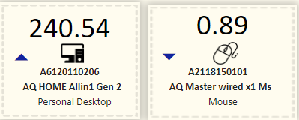
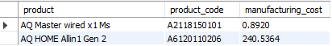
Ad_hoc Request 5
#5.Get the products that have the highest and lowest manufacturing costs.
The final output should contain these fields, product_code product manufacturing_cost
Insights: Mouse AQ Master wired x1 Ms (Variant:Standard1) has the lowest manufacturing cost. Personal Desktop AQ Home Allin1 Gen2 (Variant:Plus3) has the highest manufacturing cost.

Slide 11
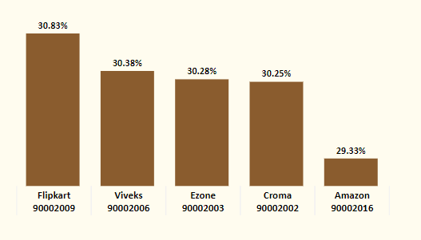
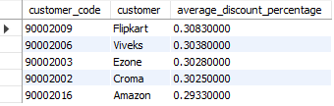
Ad_hoc Request 6
#6.Generate a report which contains the top 5 customers who received an average high pre_invoice_discount_pct for the fiscal year 2021 and in the Indian market. The final output contains these fields customer_code ,customer, average_discount_percentage
Insights: The largest average pre-invoice discount was given to Flipkart. The least average pre-invoice discount was given to Amazon.

Slide 12
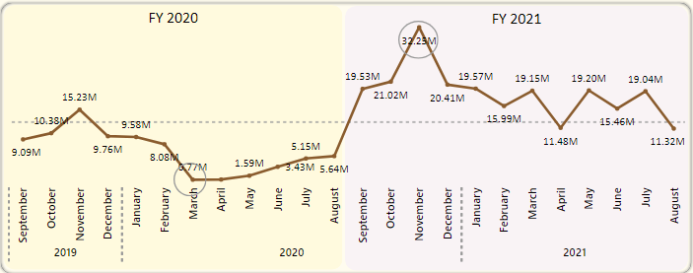
Ad_hoc Request 7
#7. Get the complete report of the Gross sales amount for the customer “Atliq
Exclusive” for each month. This analysis helps to get an idea of low and high-performing months and take strategic decisions.
The final report contains these columns: Month, Year, Gross sales Amount

Slide 13
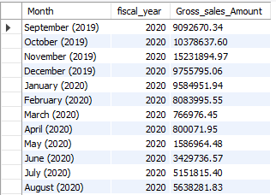
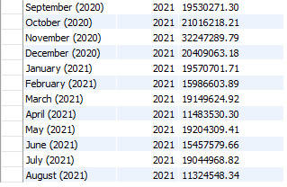
Insights: The lowest Gross sales total for both fiscal years is in March(2020). The highest Gross sales total for both fiscal years is inNovember (2020). 73.8%of the total Gross sales figure is in FY2021.

Slide 14
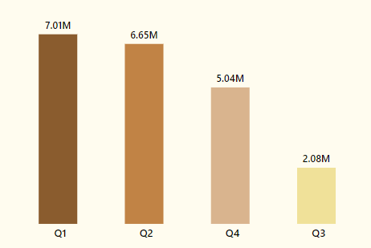
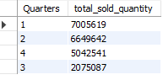
Ad_hoc Request 8
#8. In which quarter of 2020, got the maximum total_sold_quantity? The final output contains these fields sorted by the total_sold_quantity, Quarter, total_sold_quantity
Insights: Quarter 1 of FY2020 saw the most units sold overall, while Quarter 3 had the fewest.
The highest and lowest overall sold quantity is in December and March.
Quarter 1 accounts for approximately 34% ofthe total sold quantity for FY2020.

Slide 15
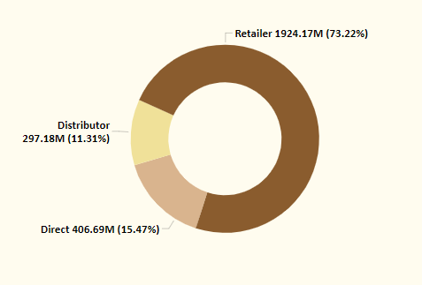
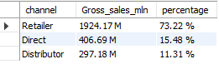
Ad_hoc Request 9
#9. Which channel helped to bring more gross sales in the fiscal year 2021 and the percentage of contribution? The final output contains these fields, channel, gross_sales_mln, percentage
Insights: Channel Retailer helped bring maximum sales to the company with 73.22% as the contribution percentage.
Channel Distributor makes the least contribution at a percentage of11.31%.

Slide 16
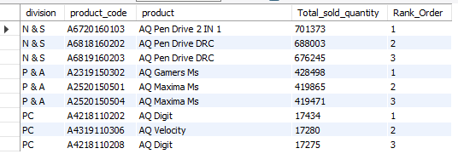
Ad_hoc Request 10
#10. Get the Top 3 products in each division that have a high total_sold_quantity in the fiscal_year 2021? The final output contains these fields, division, product_code, product, total_sold_quantity, rank_order

Slide 17
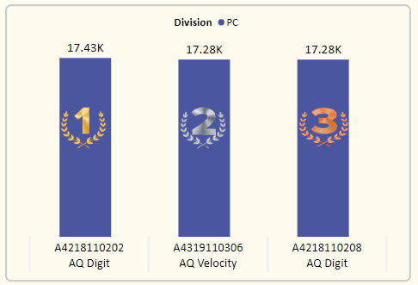
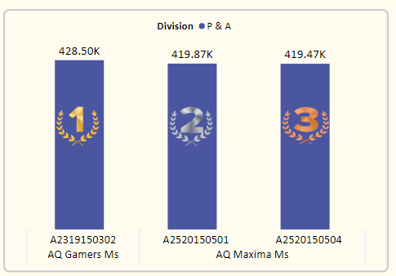
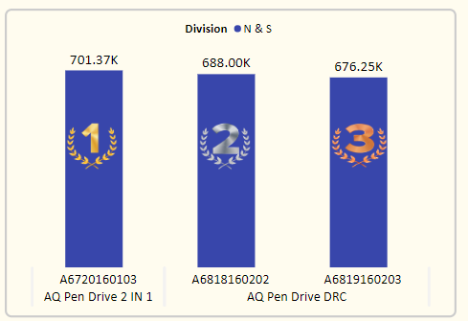
Insights: Every division has a product with different variants that appears twice in the top three products by division list.

